Slide 1

Open educational resources:
https://goo.gl/Z1g5UD
supporting equitable outcomes for all students at ACU
Dr Katarina Tuinamuana Bernice McIntyre Vicki Bourbous
L & T Conference Padlet link:
Friday 27 July 2018
https://goo.gl/Z1g5UD
Image: OER Global Logo by Jonathas Mello CC BY 3.0
Notes:
https://goo.gl/Z1g5UD

Slide 2
Padlet:
https://goo.gl/Z1g5UD
Open Educational Resources (OERs) are essential for supporting equitable outcomes for all ACU students, especially in current contexts of budgetary constraints.

Slide 3
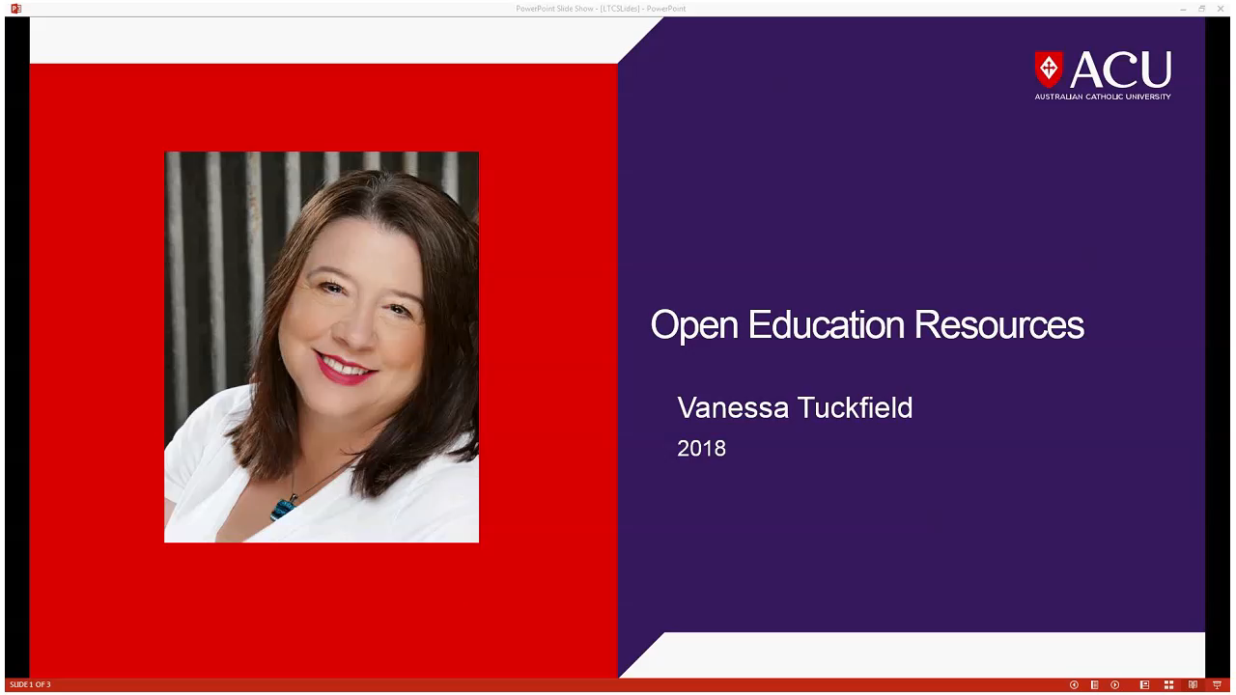

Slide 4
Padlet:
https://goo.gl/Z1g5UD
OERs: A Snapshot
ACU Faculty of Education and Arts
Higher Education in the US
Notes:
Snapshot of ACU and US research on OERs

Slide 5
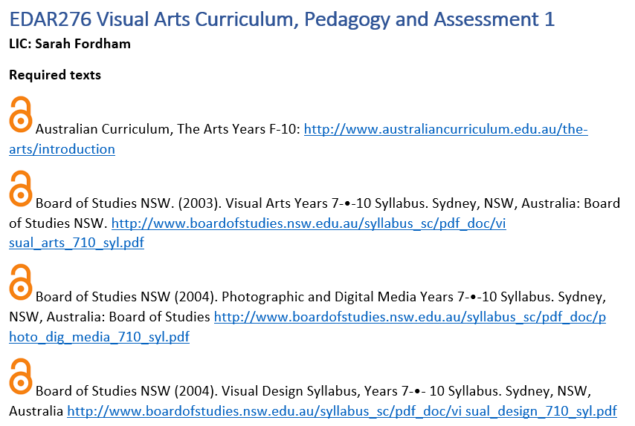
Padlet:
https://goo.gl/Z1g5UD

Slide 6

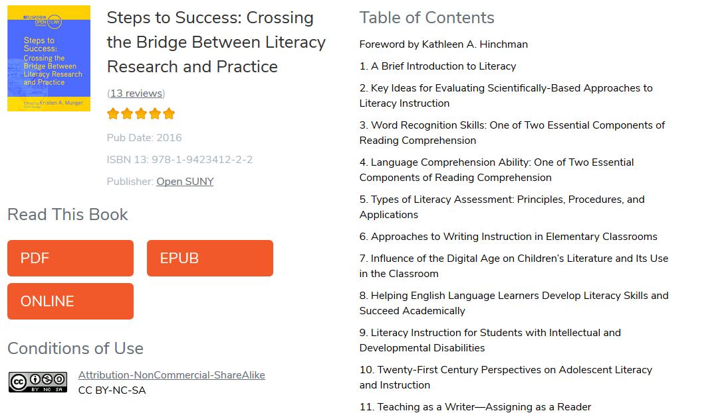
Padlet:
https://goo.gl/Z1g5UD

Slide 7
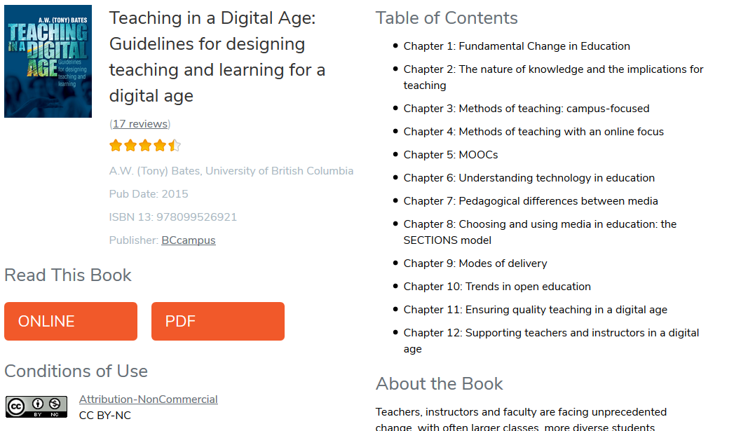
Padlet:
https://goo.gl/Z1g5UD

Slide 8
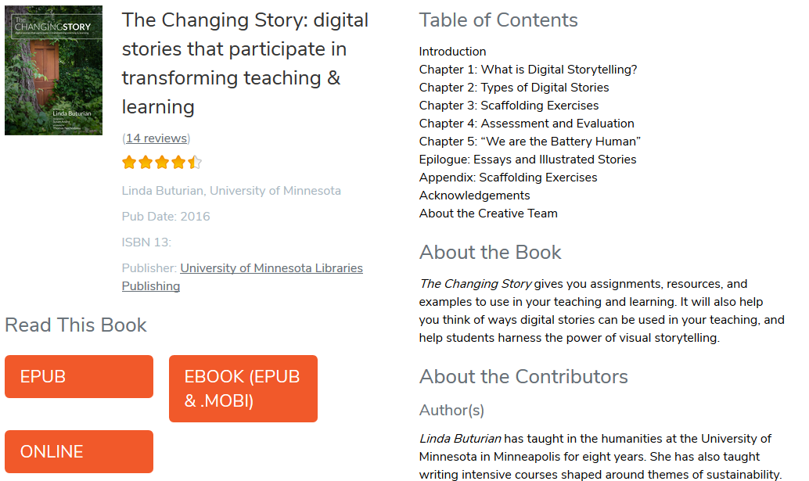
Padlet:
https://goo.gl/Z1g5UD

Slide 9
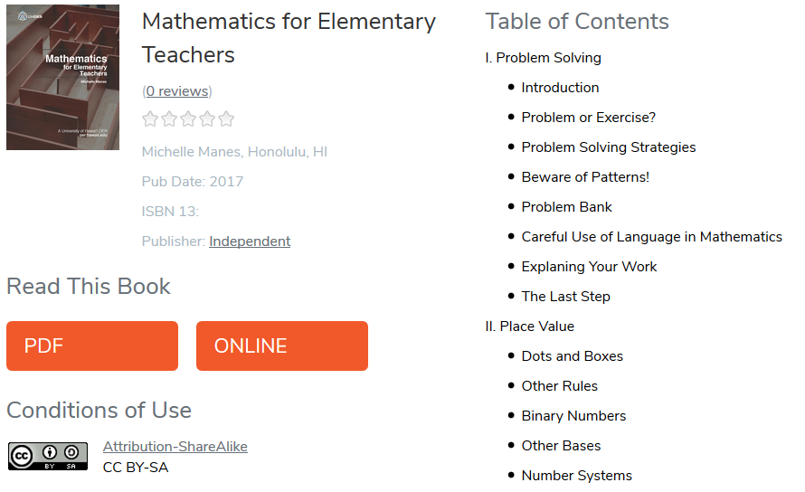
Padlet:
https://goo.gl/Z1g5UD

